Slide 1


Slide 2
Introduction
Big Data:
Big data is a term used to describe the voluminous amount of unstructured and semi-structured data a company creates.
Data that would take too much time and cost too much money to load into a relational database for analysis.
Big data doesn't refer to any specific quantity, the term is often used when speaking about petabytes and exabytes of data.

Slide 3
The New York Stock Exchange generates about one terabyte of new trade data per day.
Facebook hosts approximately 10 billion photos, taking up one petabyte of storage.
Ancestry.com, the genealogy site, stores around 2.5 petabytes of data.
The Internet Archive stores around 2 petabytes of data, and is growing at a rate of 20 terabytes per month.
The Large Hadron Collider near Geneva, Switzerland, produces about 15 petabytes of data per year.

Slide 4
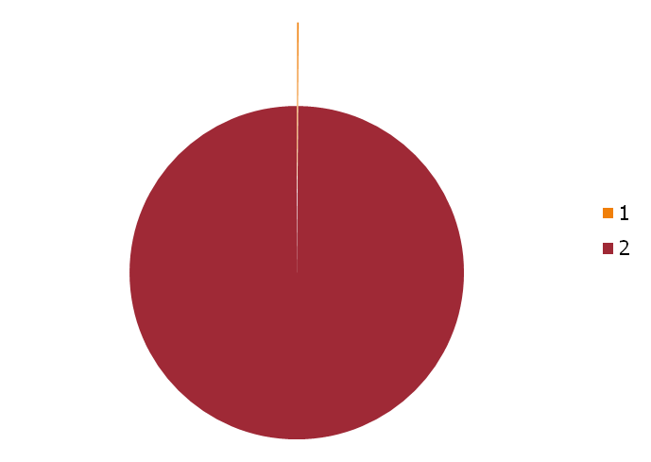
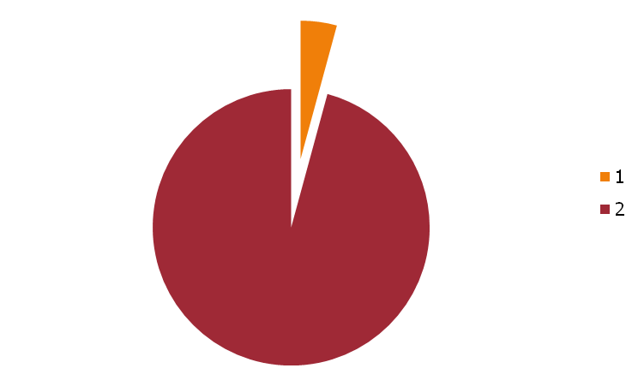
What Caused The Problem?
Year | Standard Hard Drive Size (in Mb)
1990 | 1370
2010 | 1000000
Year | Data Transfer Rate (Mbps)
1990 | 4.4
2010 | 100

Slide 5
So What Is The Problem?
The transfer speed is around 100 MB/s
A standard disk is 1 Terabyte
Time to read entire disk= 10000 seconds or 3 Hours!
Increase in processing time may not be as helpful because
  Network bandwidth is now more of a limiting factor
  Physical limits of processor chips have been reached

Slide 6

So What do We Do?
The obvious solution is that we use multiple processors to solve the same problem by fragmenting it into pieces.
Imagine if we had 100 drives, each holding one hundredth of the data. Working in parallel, we could read the data in under two minutes.

Slide 7
Distributed Computing Vs Parallelization
Parallelization- Multiple processors or CPU’s in a single machine
Distributed Computing- Multiple computers connected via a network

Slide 8
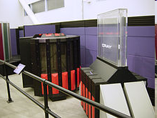
Examples
Cray-2 was a four-processor ECL vector supercomputer made by Cray Research starting in 1985

Slide 9
Distributed Computing
The key issues involved in this Solution:
Hardware failure
Combine the data after analysis
Network Associated Problems

Slide 10
What Can We Do With A Distributed Computer System?
IBM Deep Blue
Multiplying Large Matrices
Simulating several 100’s of characters-LOTRs
Index the Web (Google)
Simulating an internet size network for network experiments

Slide 11
Problems In Distributed Computing
Hardware Failure:
As soon as we start using many pieces of hardware, the chance that one will fail is fairly high.
Combine the data after analysis:
Most analysis tasks need to be able to combine the data in some way; data read from one disk may need to be combined with the data from any of the other 99 disks.

Slide 12

To The Rescue!
Apache Hadoop is a framework for running applications on large cluster built of commodity hardware.
A common way of avoiding data loss is through replication: redundant copies of the data are kept by the system so that in the event of failure, there is another copy available. The Hadoop Distributed Filesystem (HDFS), takes care of this problem.
The second problem is solved by a simple programming model- Mapreduce. Hadoop is the popular open source implementation of MapReduce, a powerful tool designed for deep analysis and transformation of very large data sets.

Slide 13
What Else is Hadoop?
A reliable shared storage and analysis system.
There are other subprojects of Hadoop that provide complementary services, or build on the core to add higher-level abstractions The various subprojects of hadoop include:
Core
Avro
Pig
HBase
Zookeeper
Hive
Chukwa

Slide 14
Hadoop Approach to Distributed Computing
The theoretical 1000-CPU machine would cost a very large amount of money, far more than 1,000 single-CPU.
Hadoop will tie these smaller and more reasonably priced machines together into a single cost-effective compute cluster.
Hadoop provides a simplified programming model which allows the user to quickly write and test distributed systems, and its’ efficient, automatic distribution of data and work across machines and in turn utilizing the underlying parallelism of the CPU cores.

Slide 15
MapReduce

Slide 16
MapReduce
Hadoop limits the amount of communication which can be performed by the processes, as each individual record is processed by a task in isolation from one another
By restricting the communication between nodes, Hadoop makes the distributed system much more reliable. Individual node failures can be worked around by restarting tasks on other machines.
The other workers continue to operate as though nothing went wrong, leaving the challenging aspects of partially restarting the program to the underlying Hadoop layer.
Map : (in_value,in_key)→(out_key, intermediate_value)
Reduce: (out_key, intermediate_value)→ (out_value list)

Slide 17
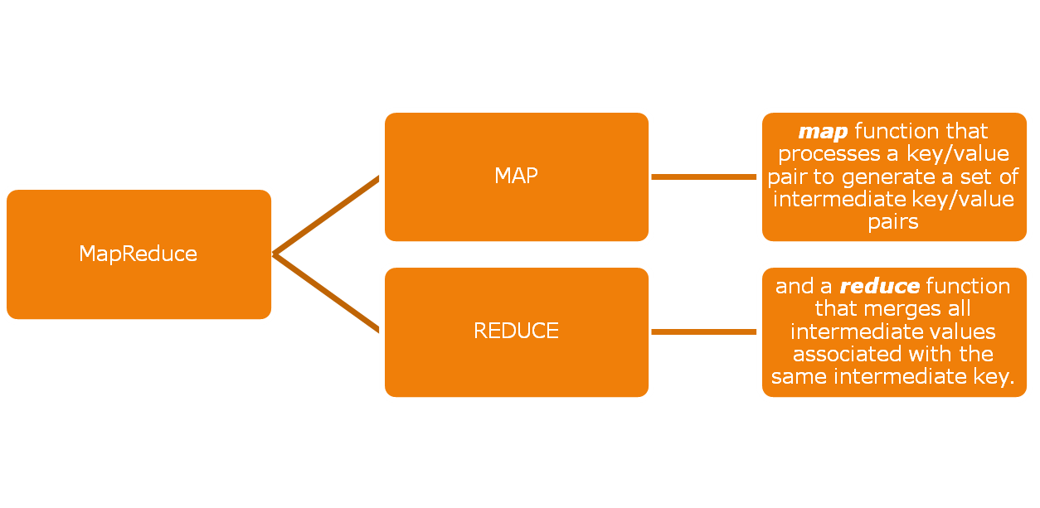
What is MapReduce?
MapReduce is a programming model
Programs written in this functional style are automatically parallelized and executed on a large cluster of commodity machines
MapReduce is an associated implementation for processing and generating large data sets.

Slide 18
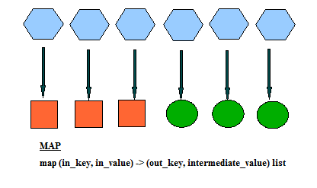
The Programming Model Of MapReduce
Map, written by the user, takes an input pair and produces a set of intermediate key/value pairs. The MapReduce library groups together all intermediate values associated with the same intermediate key I and passes them to the Reduce function.

Slide 19
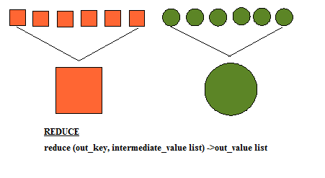
The Reduce function, also written by the user, accepts an intermediate key I and a set of values for that key. It merges together these values to form a possibly smaller set of values

Slide 20
This abstraction allows us to handle lists of values that are too large to fit in memory.
Example:
// key: document name
// value: document contents
for each word w in value:
EmitIntermediate(w, "1");
reduce(String key, Iterator values):
// key: a word
// values: a list of counts
int result = 0;
for each v in values:
result += ParseInt(v);
Emit(AsString(result));

Slide 21
Orientation of Nodes
Data Locality Optimization:
The computer nodes and the storage nodes are the same. The Map-Reduce framework and the Distributed File System run on the same set of nodes. This configuration allows the framework to effectively schedule tasks on the nodes where data is already present, resulting in very high aggregate bandwidth across the cluster.
If this is not possible: The computation is done by another processor on the same rack.
“Moving Computation is Cheaper than Moving Data”

Slide 22
How MapReduce Works
A Map-Reduce job usually splits the input data-set into independent chunks which are processed by the map tasks in a completely parallel manner.
The framework sorts the outputs of the maps, which are then input to the reduce tasks.
Typically both the input and the output of the job are stored in a file-system. The framework takes care of scheduling tasks, monitoring them and re-executes the failed tasks.
A MapReduce job is a unit of work that the client wants to be performed: it consists of the input data, the MapReduce program, and configuration information. Hadoop runs the job by dividing it into tasks, of which there are two types: map tasks and reduce tasks

Slide 23
Fault Tolerance
There are two types of nodes that control the job execution process: tasktrackers and jobtrackers
The jobtracker coordinates all the jobs run on the system by scheduling tasks to run on tasktrackers.
Tasktrackers run tasks and send progress reports to the jobtracker, which keeps a record of the overall progress of each job.
If a tasks fails, the jobtracker can reschedule it on a different tasktracker.

Slide 24
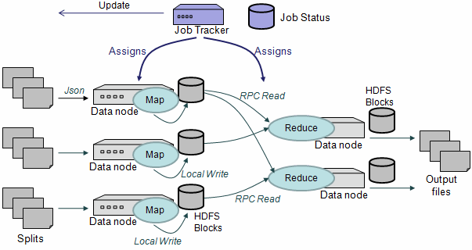

Slide 25
Input Splits
Input splits: Hadoop divides the input to a MapReduce job into fixed-size pieces called input splits, or just splits. Hadoop creates one map task for each split, which runs the user-defined map function for each record in the split.
The quality of the load balancing increases as the splits become more fine-grained.
BUT if splits are too small, then the overhead of managing the splits and of map task creation begins to dominate the total job execution time. For most jobs, a good split size tends to be the size of a HDFS block, 64 MB by default.
WHY?
Map tasks write their output to local disk, not to HDFS. Map output is intermediate output: it’s processed by reduce tasks to produce the final output, and once the job is complete the map output can be thrown away. So storing it in HDFS, with replication, would be a waste of time. It is also possible that the node running the map task fails before the map output has been consumed by the reduce task.

Slide 26
Input to Reduce Tasks
Reduce tasks don’t have the advantage of data locality—the input to a single reduce task is normally the output from all mappers.

Slide 27
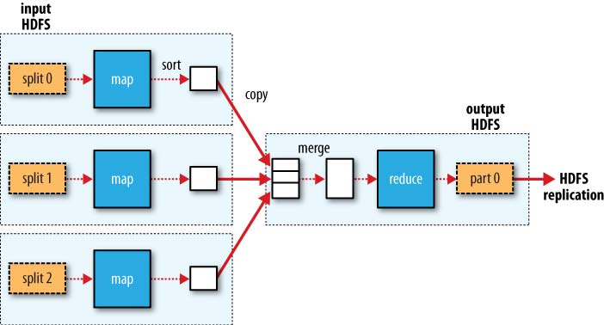
MapReduce data flow with a single reduce task

Slide 28
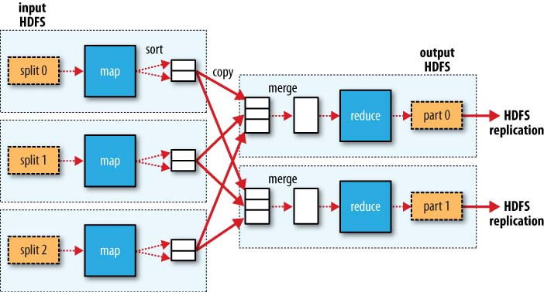
MapReduce data flow with multiple reduce tasks

Slide 29
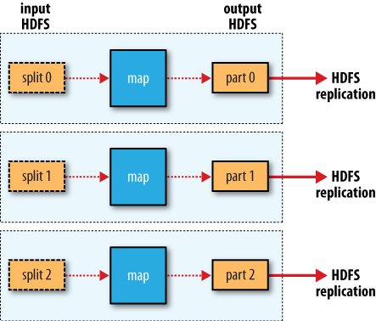
MapReduce data flow with no reduce tasks

Slide 30
Combiner Functions
Many MapReduce jobs are limited by the bandwidth available on the cluster.
In order to minimize the data transferred between the map and reduce tasks, combiner functions are introduced.
Hadoop allows the user to specify a combiner function to be run on the map output—the combiner function’s output forms the input to the reduce function.
Combiner finctions can help cut down the amount of data shuffled between the maps and the reduces.

Slide 31
Hadoop Streaming:
  Hadoop provides an API to MapReduce that allows you to write your map and reduce functions in languages other than Java.
  Hadoop Streaming uses Unix standard streams as the interface between Hadoop and your program, so you can use any language that can read standard input and write to standard output to write your MapReduce program.

Slide 32
Hadoop Pipes:
Hadoop Pipes is the name of the C++ interface to Hadoop MapReduce.
Unlike Streaming, which uses standard input and output to communicate with the map and reduce code, Pipes uses sockets as the channel over which the tasktracker communicates with the process running the C++ map or reduce function. JNI is not used.

Slide 33
HADOOP DISTRIBUTED FILESYSTEM (HDFS)
Filesystems that manage the storage across a network of machines are called distributed filesystems.
Hadoop comes with a distributed filesystem called HDFS, which stands for Hadoop Distributed Filesystem.
HDFS, the Hadoop Distributed File System, is a distributed file system designed to hold very large amounts of data (terabytes or even petabytes), and provide high-throughput access to this information.

Slide 34
Problems In Distributed File Systems
Making distributed filesystems is more complex than regular disk filesystems. This is because the data is spanned over multiple nodes, so all the complications of network programming kick in.
    Hardware Failure
An HDFS instance may consist of hundreds or thousands of server machines, each storing part of the file system’s data. The fact that there are a huge number of components and that each component has a non-trivial probability of failure means that some component of HDFS is always non-functional. Therefore, detection of faults and quick, automatic recovery from them is a core architectural goal of HDFS.
    Large Data Sets
Applications that run on HDFS have large data sets. A typical file in HDFS is gigabytes to terabytes in size. Thus, HDFS is tuned to support large files. It should provide high aggregate data bandwidth and scale to hundreds of nodes in a single cluster. It should support tens of millions of files in a single instance.

Slide 35
Goals of HDFS
    Streaming Data Access
Applications that run on HDFS need streaming access to their data sets. They are not general purpose applications that typically run on general purpose file systems. HDFS is designed more for batch processing rather than interactive use by users. The emphasis is on high throughput of data access rather than low latency of data access. POSIX imposes many hard requirements that are not needed for applications that are targeted for HDFS. POSIX semantics in a few key areas has been traded to increase data throughput rates.
    Simple Coherency Model
HDFS applications need a write-once-read-many access model for files. A file once created, written, and closed need not be changed. This assumption simplifies data coherency issues and enables high throughput data access. A Map/Reduce application or a web crawler application fits perfectly with this model. There is a plan to support appending-writes to files in the future.

Slide 36
    “Moving Computation is Cheaper than Moving Data”
A computation requested by an application is much more efficient if it is executed near the data it operates on. This is especially true when the size of the data set is huge. This minimizes network congestion and increases the overall throughput of the system. The assumption is that it is often better to migrate the computation closer to where the data is located rather than moving the data to where the application is running. HDFS provides interfaces for applications to move themselves closer to where the data is located.
    Portability Across Heterogeneous Hardware and Software Platforms HDFS has been designed to be easily portable from one platform to another. This facilitates widespread adoption of HDFS as a platform of choice for a large set of applications.

Slide 37
Design of HDFS
Very large files
Files that are hundreds of megabytes, gigabytes, or terabytes in size. There are Hadoop clusters running today that store petabytes of data.
Streaming data access
HDFS is built around the idea that the most efficient data processing pattern is a write-once, read-many-times pattern.
A dataset is typically generated or copied from source, then various analyses are performed on that dataset over time. Each analysis will involve a large proportion of the dataset, so the time to read the whole dataset is more important than the latency in reading the first record.

Slide 38
Low-latency data access
Applications that require low-latency access to data, in the tens of milliseconds
range, will not work well with HDFS. Remember HDFS is optimized for delivering a high throughput of data, and this may be at the expense of latency. HBase (Chapter 12) is currently a better choice for low-latency access.
Multiple writers, arbitrary file modifications
Files in HDFS may be written to by a single writer. Writes are always made at the end of the file. There is no support for multiple writers, or for modifications at arbitrary offsets in the file. (These might be supported in the future, but they are likely to be relatively inefficient.)

Slide 39
Lots of small files
Since the namenode holds filesystem metadata in memory, the limit to the number of files in a filesystem is governed by the amount of memory on the namenode. As a rule of thumb, each file, directory, and block takes about 150 bytes. So, for example, if you had one million files, each taking one block, you would need at least 300 MB of memory. While storing millions of files is feasible, billions is beyond the capability of current hardware.

Slide 40
Commodity hardware
Hadoop doesn’t require expensive, highly reliable hardware to run on. It’s designed to run on clusters of commodity hardware for which the chance of node failure across the cluster is high, at least for large clusters. HDFS is designed to carry on working without a noticeable interruption to the user in the face of such failure. It is also worth examining the applications for which using HDFS does not work so well. While this may change in the future, these are areas where HDFS is not a good fit today:

Slide 41
Concepts of HDFS:

Slide 42
Block Abstraction
Blocks:
A block is the minimum amount of data that can be read or written.
64 MB by default.
Files in HDFS are broken into block-sized chunks, which are stored as independent units.
HDFS blocks are large compared to disk blocks, and the reason is to minimize the cost of seeks. By making a block large enough, the time to transfer the data from the disk can be made to be significantly larger than the time to seek to the start of the block. Thus the time to transfer a large file made of multiple blocks operates at the disk transfer rate.

Slide 43
Benefits of Block Abstraction
A file can be larger than any single disk in the network. There’s nothing that requires the blocks from a file to be stored on the same disk, so they can take advantage of any of the disks in the cluster.
Making the unit of abstraction a block rather than a file simplifies the storage subsystem.
Blocks provide fault tolerance and availability. To insure against corrupted blocks and disk and machine failure, each block is replicated to a small number of physically separate machines (typically three). If a block becomes unavailable, a copy can be read from another location in a way that is transparent to the client.

Slide 44
Hadoop Archives
HDFS stores small files inefficiently, since each file is stored in a block, and block metadata is held in memory by the namenode. Thus, a large number of small files can eat up a lot of memory on the namenode.
Hadoop Archives, or HAR files, are a file archiving facility that packs files into HDFS blocks more efficiently, thereby reducing namenode memory usage while still allowing transparent access to files.
Hadoop Archives can be used as input to MapReduce.
Notes:
(Note, however, that small files do not take up any more disk space than is required to store the raw contents of the file. For example, a 1 MB file stored with a block size of 128 MB uses 1 MB of disk space, not 128 MB.)

Slide 45
Limitations of Archiving
There is currently no support for archive compression, although the files that go into the archive can be compressed
Archives are immutable once they have been created. To add or remove files, you must recreate the archive

Slide 46
Namenodes and Datanodes
A HDFS cluster has two types of node operating in a master-worker pattern: a namenode (the master) and a number of datanodes (workers).
The namenode manages the filesystem namespace. It maintains the filesystem tree and the metadata for all the files and directories in the tree.
Datanodes are the work horses of the filesystem. They store and retrieve blocks when they are told to (by clients or the namenode), and they report back to the namenode periodically with lists of blocks that they are storing.

Slide 47
Without the namenode, the filesystem cannot be used. In fact, if the machine running the namenode were obliterated, all the files on the filesystem would be lost since there would be no way of knowing how to reconstruct the files from the blocks on the datanodes.

Slide 48
Important to make the namenode resilient to failure, and Hadoop provides two mechanisms for this:
is to back up the files that make up the persistent state of the filesystem metadata. Hadoop can be configured so that the namenode writes its persistent state to multiple filesystems.
Another solution is to run a secondary namenode. The secondary namenode usually runs on a separate physical machine, since it requires plenty of CPU and as much memory as the namenode to perform the merge. It keeps a copy of the merged namespace image, which can be used in the event of the namenode failing

Slide 49
File System Namespace
HDFS supports a traditional hierarchical file organization. A user or an application can create and remove files, move a file from one directory to another, rename a file, create directories and store files inside these directories.
HDFS does not yet implement user quotas or access permissions. HDFS does not support hard links or soft links. However, the HDFS architecture does not preclude implementing these features.
The Namenode maintains the file system namespace. Any change to the file system namespace or its properties is recorded by the Namenode. An application can specify the number of replicas of a file that should be maintained by HDFS. The number of copies of a file is called the replication factor of that file. This information is stored by the Namenode.

Slide 50
Data Replication
The blocks of a file are replicated for fault tolerance.
The NameNode makes all decisions regarding replication of blocks. It periodically receives a Heartbeat and a Blockreport from each of the DataNodes in the cluster. Receipt of a Heartbeat implies that the DataNode is functioning properly.
A Blockreport contains a list of all blocks on a DataNode.
When the replication factor is three, HDFS’s placement policy is to put one replica on one node in the local rack, another on a different node in the local rack, and the last on a different node in a different rack.

Slide 51
Bibliography
Hadoop- The Definitive Guide, O’Reilly 2009, Yahoo! Press
MapReduce: Simplified Data Processing on Large Clusters, Jeffrey Dean and Sanjay Ghemawat
Ranking and Semi-supervised Classification on Large Scale Graphs Using Map-Reduce, Delip Rao, David Yarowsky, Dept. of Computer Science, Johns Hopkins University
Improving MapReduce Performance in Heterogeneous Environments, Matei Zaharia, Andy Konwinski, Anthony D. Joseph, Randy Katz, Ion Stoica, University of California, Berkeley
MapReduce in a Week By Hannah Tang, Albert Wong, Aaron Kimball, Winter 2007

